Slide 1


π
Langgraph
July 2025
π

Slide 2
π
workflow vs. agent
Basics ?
typeDictionary
Pydantic
JsonOutputParser
StructuredoutputParser
Pydanticoutparser
π

Slide 3
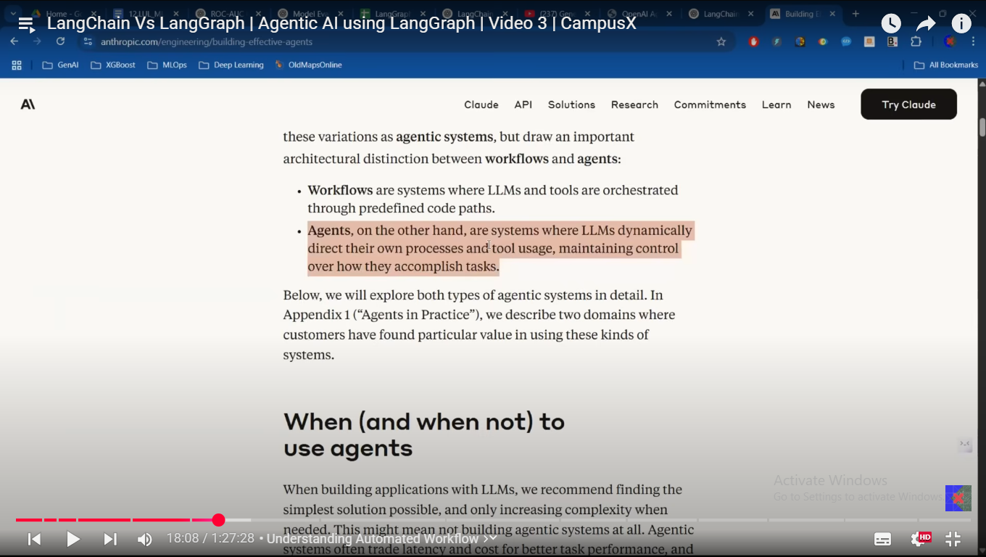
π

Slide 4
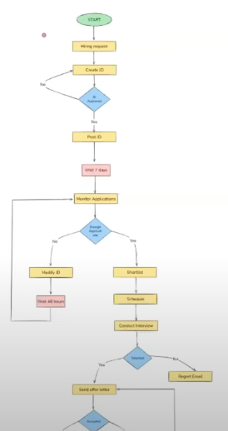
π
The Flowchart which is showing it is not an agentic application but it is workflow
above flow chart is already made and every time this flow chart is displayed in he same order and it will be executed in the same order and this flow chart is developed by developer that's why we called it workflow not agent
in case of agent the complete flow chart will be made for agent and it will by dynamic.
first run there will be another flow chart and second run there will be another flow chart
Notes:
Content: https://www.linkedin.com/pulse/chunking-strategies-ai-data-kash-kashyap-0lghe/

Slide 5
π
Workflow
are system where llm and tool are orchestrated through predefined code path
Agentic AI Application
on the other hand ,agent are those system where llm dynamically direct their own process and tool usage ,maintaining control over how the accomplish task

Slide 6
π
Notes:
Content: https://www.linkedin.com/pulse/chunking-strategies-ai-data-kash-kashyap-0lghe/

Slide 7
π
Notes:
Content: https://www.linkedin.com/pulse/chunking-strategies-ai-data-kash-kashyap-0lghe/

Slide 8
π
Notes:
Content: https://www.linkedin.com/pulse/chunking-strategies-ai-data-kash-kashyap-0lghe/

